Slide 1

CMR COLLEGE OF ENGINEERING & TECHNOLOGY
Kandlakoya, Medchal, Hyderabad - 501401
Department of Computer Science and Engineering
SkyLinker Aero Pathways
P.Shreyansh Srikar Rao (20H51A05D2)
P.Nithin Varma Reddy (20H51A05F1)
V.Venkata Sai charan (20H51A0578)
Under the esteemed guidance of
Ms. B. Anuradha(Assistant professor)
Batch-83

Slide 2
Outline
Abstract
Introduction
Literature Review
Research Objective
Problem Definition
Research Work
Results
Comparison and Limitations
Conclusion
Future Work
References
Notes:
2

Slide 3
Abstract
Notes:
3

Slide 4
ABSTRACT
The SkyLinker Aero Pathways Application revolutionizes real-time flight tracking by leveraging public ADS-B feeds. Built using cutting-edge web technologies like JavaScript, React. The app offers dynamic front-end interactions, allowing users to view flights on interactive maps.
A backend microservices architecture handles notifications, predictive algorithms, and flight data retrieval through RESTful APIs. Cloud platforms ensure scalable hosting while databases like MONGODB which is a NOSQL database manage data efficiently.
This fusion of real-time monitoring and predictive insights enhances the travel experience for both enthusiasts and regular travellers.

Slide 5
Introduction
Notes:
5

Slide 6

Introduction
SkyLinker Aero Pathways is a full-stack application where tracking of your aircraft is now a step away! This website combines real-time ADS-B data with cutting-edge technology, presenting a dynamic and responsive interface for travelers and aviation enthusiasts.
Dive into a seamless experience, backed by microservices architecture, modern web technologies, and cloud support. With SkyLinker Aero Pathways, we're not just tracking flights but redefining how we interact with aviation data.
Notes:
6

Slide 7
Literature Review

Slide 8
S.No | Authors and Journal Name& Year of publication | Problem Statement | Name of the Proposed solution/Method | Solution | Remarks
1 | Alexandre M. Bayen and Claire J. Tomlin. CASE STUDY – AIR TRAFFIC MANAGEMENT SYSTEMS(2002) | The problem statement of air traffic management systems (ATMS) is to ensure the safe and efficient flow of air traffic. This is a challenging task, as ATMS must deal with a complex and dynamic environment, including a wide variety of aircraft types, weather conditions, and air traffic control systems. | NextGen Air Traffic Management System (NextGen ATMS) | A next-generation air traffic management system (ATMS) that leverages artificial intelligence (AI), machine learning (ML), and big data analytics can improve capacity, safety, efficiency, and flexibility in the following ways: Capacity:. Safety: Efficiency: Flexibility | Improved safety: AI, ML, and big data analytics can be used to develop systems that can better predict and prevent potential hazards. This could lead to a significant reduction in the number of aviation accidents and incidents. Increased efficiency: Improved safety Reduced environmental impact:. Increased capacity:
2 | A Systems Approach to Identifying Aircraft Equipage Requirements, Benefits, and Risks of ADS-B Applications by Marisa Rachael Jenkins on Februrary 2009. | The key elements of the problem statement are: Existing flight tracking apps and websites rely on outdated technologies that cannot deliver real-time updates and lack predictive analytics capabilities. Their user interfaces are often not intuitive or interactive, making flight tracking tedious. There is a need for a modern flight tracking solution that utilizes: | Real-Time Air Traffic Management System (Real-Time ATMS) | Architecture: Incorporate historical flight data for training predictive models Build intuitive web interfaces with ReactJS and mobile apps with React Native Integrate interactive maps for visualizing flight positions and details Predictive Analytics: Collect and analyze historical flight status data Identify patterns and indicators that correlate with delays User Experience: Enable simple flight search by route, airline, flight number etc. Provide live flight status updates and notifications Present details like aircraft position, altitude, speed visually. | Here are some potential remarks on the proposed flight tracking solution: The microservices-based architecture aligns with modern best practices for building scalable and resilient systems to handle growing flight data volumes. Leveraging ADS-B and direct airline feeds provides comprehensive real-time flight monitoring capabilities. This overcomes limitations of public flight data sources. Incorporating historical flight status data unlocks the ability to implement predictive models

Slide 9
S.No | Authors and Journal Name& Year of publication | Problem Statement | Name of the Proposed solution/Method | Solution | Remarks
3 | COLLECTION AND PROCESSING OF FLIGHT INFORMATION ON FLIGHTRADAR24 PROJECT Karina KALAGIREVA, Veselin RADKOV.2016 | The problem statement is that there is a need for a way to track air traffic over large bodies of water and over land in the presence of vast uninhabited areas where it is impossible to deploy radars. | Flightradar24 | Flightradar24 proposed solution impossible to deploy radars is to use a combination of Automatic Dependent Surveillance-Broadcast (ADS-B) and Multilateration (MLAT). ADS-B is a system where aircraft broadcast their position, altitude, and speed to other aircraft and ground stations. Flightradar24 has a network of over 250,000 ADS-B ground stations around the world. This network allows Flightradar24 to track aircraft even in areas where there are no radar stations. MLAT is a technique that can be used to determine the position of an aircraft using the time difference of arrival (TDOA) of ADS-B signals at multiple ground stations. MLAT is not as accurate as radar. | Improved safety: Flightradar24's solution can help to improve safety by providing air traffic controllers with a more complete picture of the air traffic situation. . Increased efficiency: flight routes and to reduce delays. Reduced environmental impact:
4 | Original and Low-Cost ADS-B System to Fulfill Air Traffic Safety Obligations during High Power LIDAR Operation By Frédéric Peyrin 1,* Patrick Fréville , Nadège Montoux and Jean-Luc Baray.March 2023 | The problem statement for this system is to design a low-cost and reliable system that can accurately detect aircraft in the vicinity of the LIDAR and shut off the laser promptly to avoid any potential hazards to aviation safety. | ADS-B Air Safety System for LIDAR | Uses ADS-B technology to detect aircraft near LIDAR Shuts off laser emission when aircraft are within a certain distance Low-cost, reliable, and accurate Successfully accredited by French air authorities Rate of missing data due to air traffic interruption is about 2% Potential to be widely deployed in LIDAR observatories and used alongside portable LIDARs for field campaigns | Accurate aircraft detection Not disturbed by birds or UAVs Handles multiple aircraft simultaneously Applies safety procedure even in degraded mode Accredited by French air authorities Low rate of missing data Potential for widespread deployment

Slide 10
Research Objectives
Notes:
10

Slide 11
Research objectives
Capture accurate, real-time flight positions.
Deliver an intuitive and detailed user interface.
Provide predictive insights on flight paths and delays.
Ensure scalability and high performance.
Offer robust data management and storage solutions.

Slide 12
Problem Definition
Notes:
12

Slide 13
Problem Definition
Overly complex and non-user-friendly interfaces.
- Design an intuitive interface that caters to both casual travelers and aviation enthusiasts, ensuring ease of use and detailed data visualization.
Performance and reliability challenges with real-time tracking.
- Ensure efficient resource consumption to handle continuous real-time tracking, making it feasible for prolonged usage.
Limited predictive tools in current market offerings.
- Incorporate algorithms that can provide predictive insights about flight paths and potential delays.
Scalability concerns in the face of growing air travel.
- Harness cloud platforms to ensure the application can handle increased user loads while maintaining consistent performance.

Slide 14
Research work

Slide 15
Proposed solution
Implement a 2D interactive globe for dynamic flight route visualization with functionalities such as zoom.
Integrate real-time flight data APIs to display crucial flight statistics like altitude, speed, and ETA.
Provide comprehensive flight details, including aircraft type, registration, and airline, along with live weather and NOTAMs.
Employ machine learning models to predict flight delays and recommend efficient alternative routes.
Design a clean, intuitive UI that is mobile-responsive and offers customizable user dashboards.
Build a scalable, secure architecture using technologies like React for the front end and Node.js for the back end, ensuring data protection compliance.

Slide 16
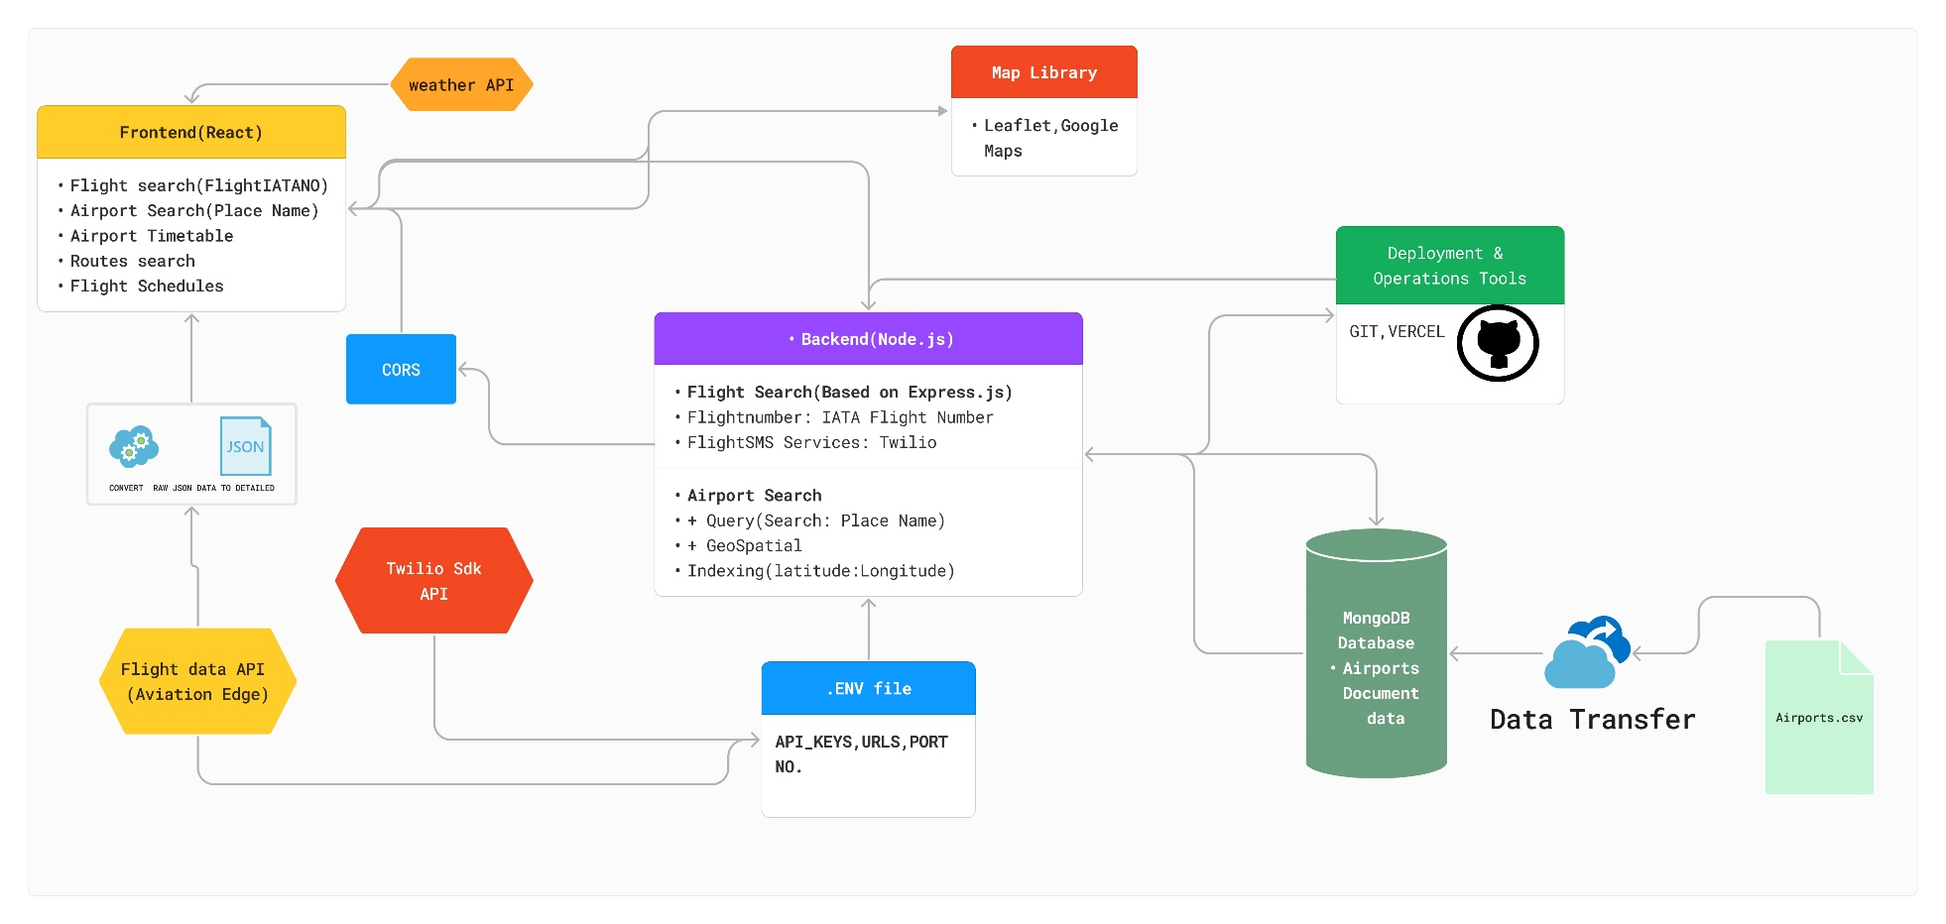
App Architecture
System Architecture of Skylinker Aero Pathways

Slide 17
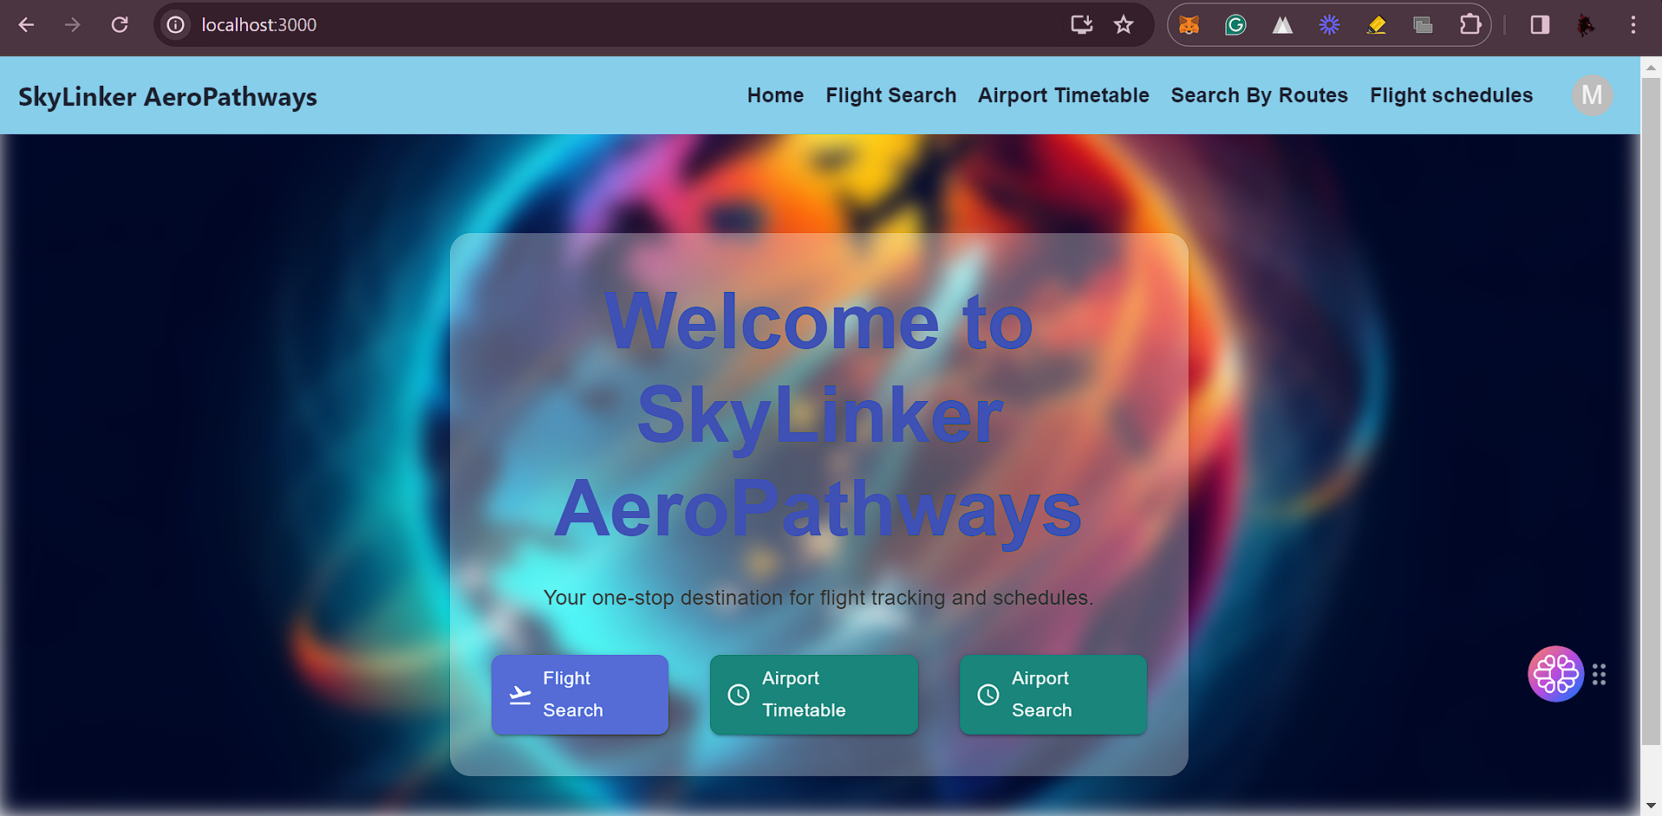
Results of SkyLinker AeroPathways
HomePage of React Website

Slide 18
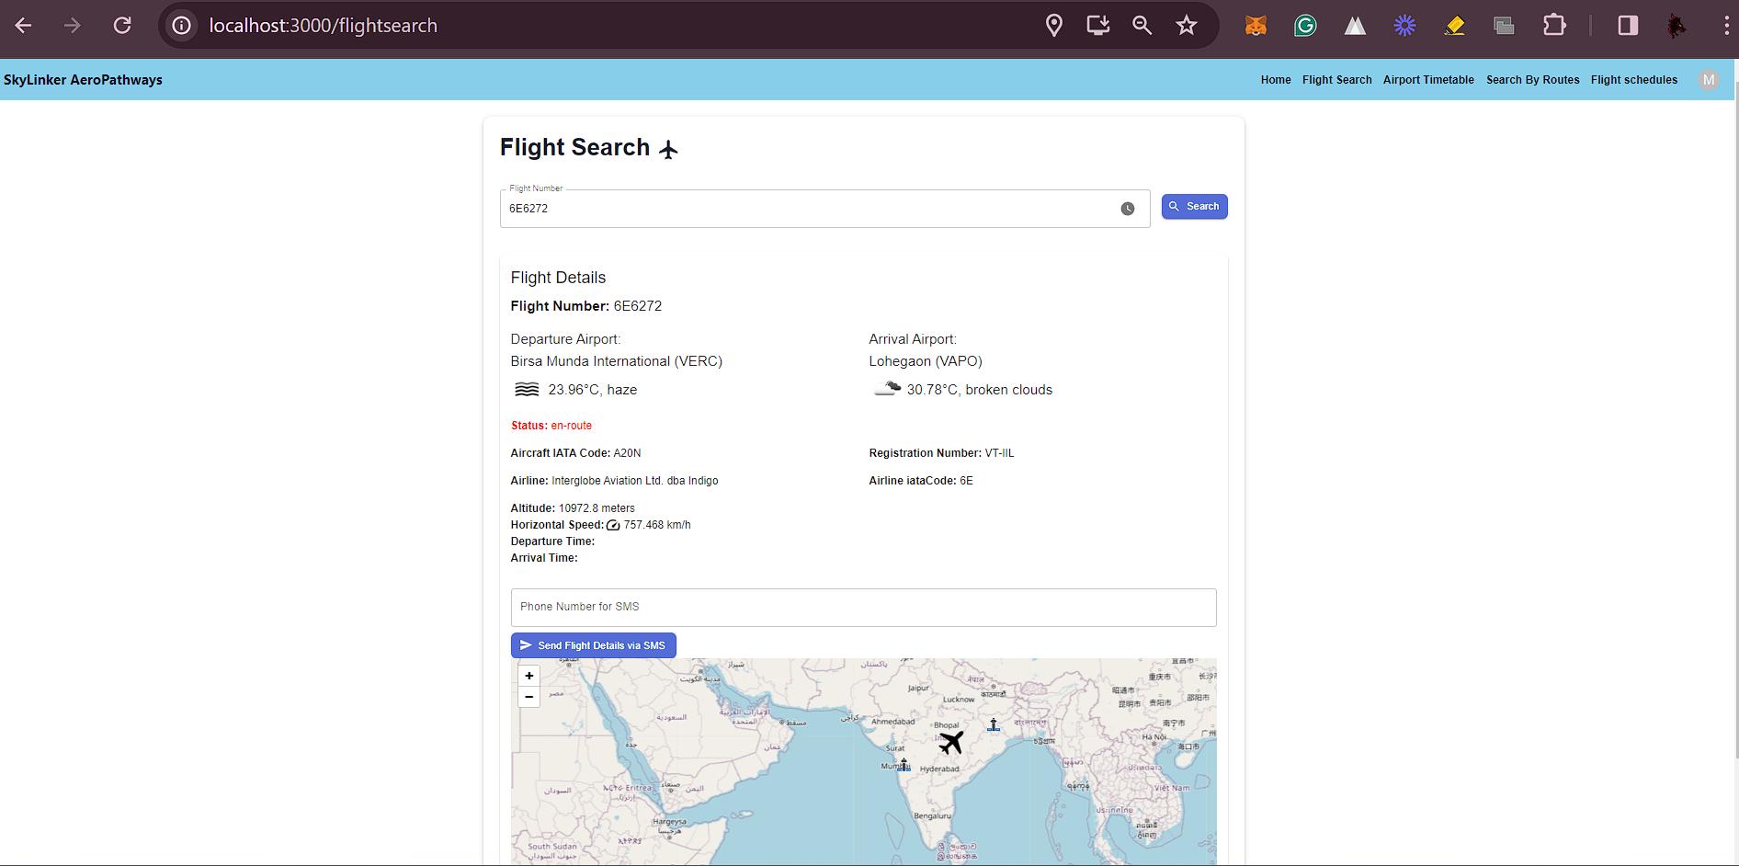
Flightsearch with flightdetails-React Website

Slide 19
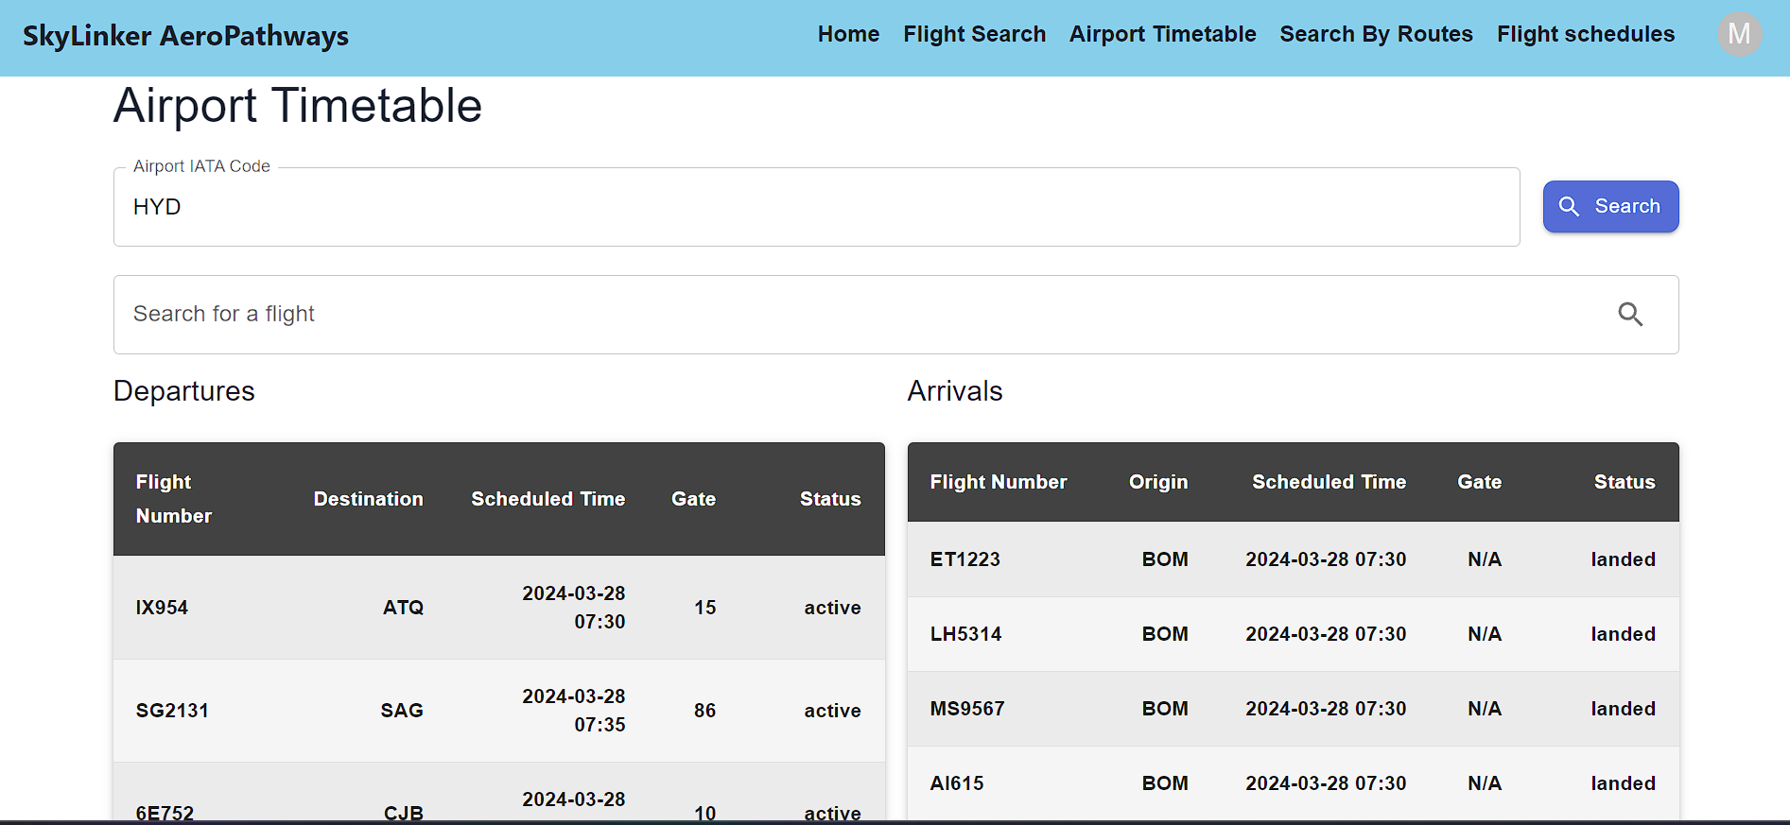
Airport TimeTable in React Website

Slide 20
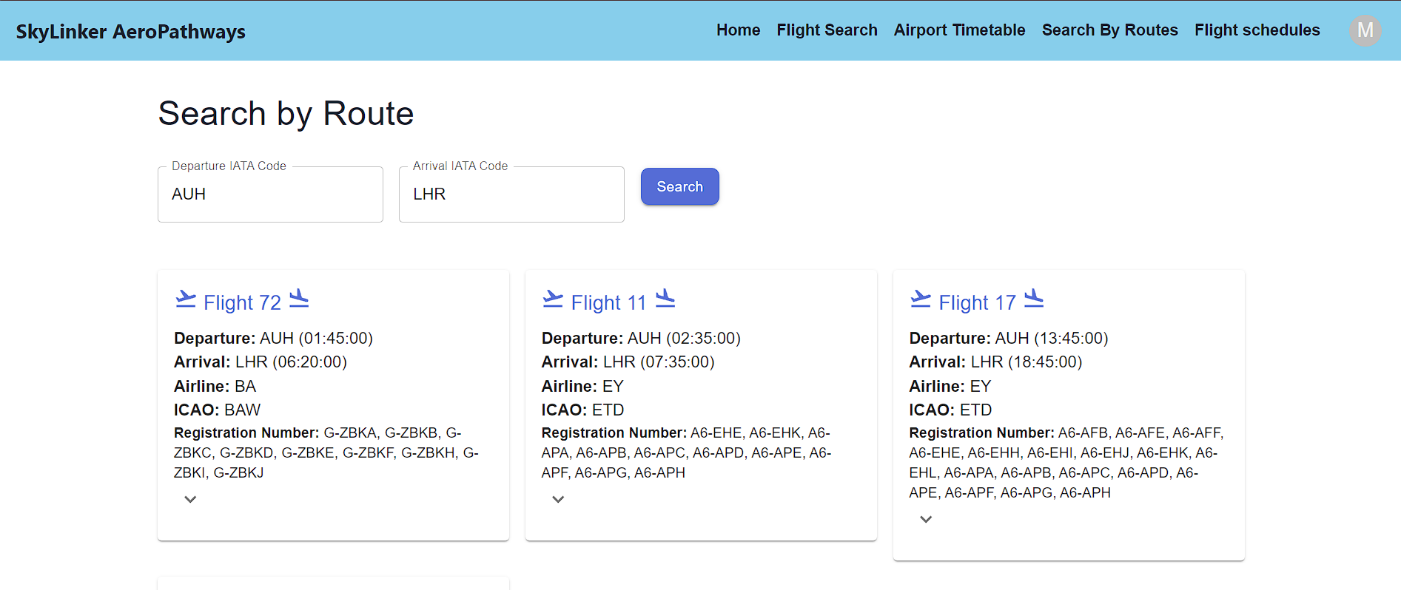
RouteSearch in React website

Slide 21
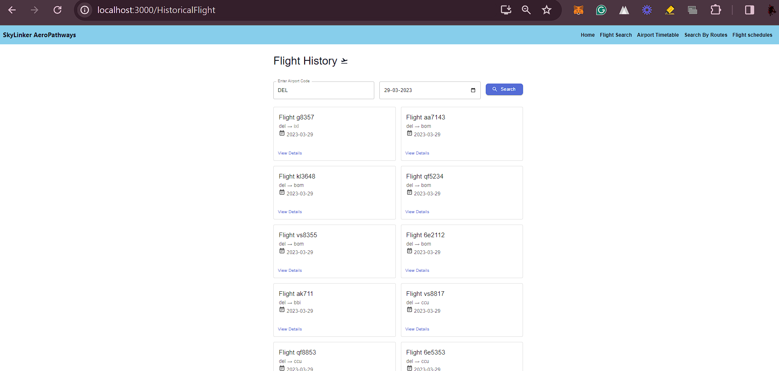
FlightSchedule React website

Slide 22
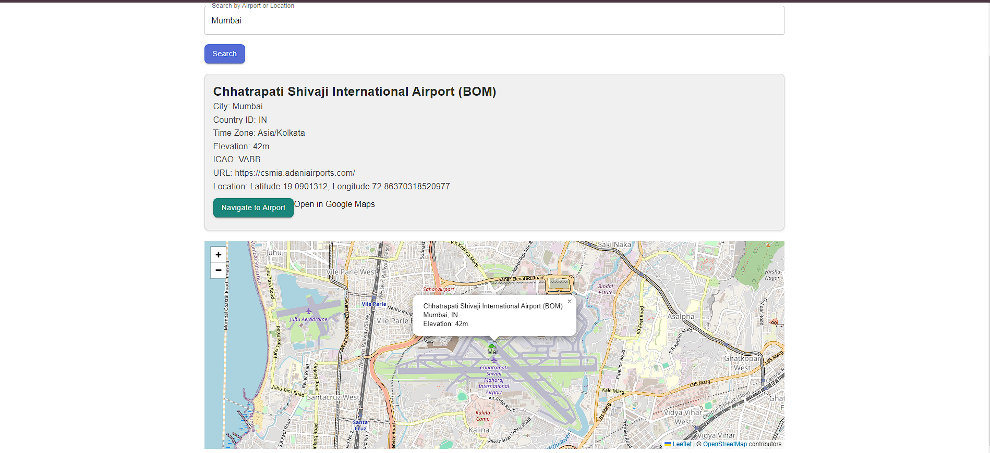
Airport search React Website

Slide 23
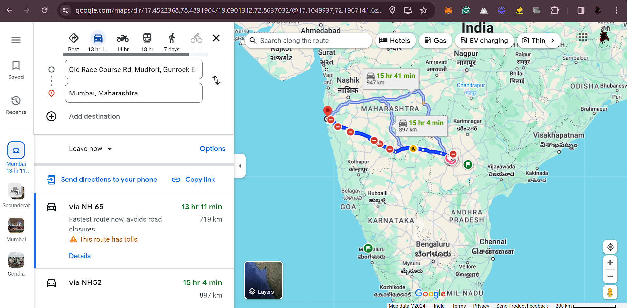
Airport Navigation through Google maps React Website

Slide 24
Comparison and Limitations

Slide 25
Comparison
Intuitive Interface: Skylinker Aero Pathways offers a modern, user-friendly design, unlike traditional flight tracking services.
Enhanced Search: Skylinker provides advanced search options, unlike standard search functionalities.
Strong Security: Skylinker ensures secure authentication and data protection, unlike basic security measures.
Added Value Services: Skylinker offers community engagement, VR support, and destination guides, setting it apart from typical flight tracking platforms.

Slide 26
Limitations
Dependence on ADS-B equipped aircraft.
Possible inaccuracies due to source data.
Predictive analytics cannot guarantee absolute predictions.
Potential performance challenges during high traffic.
Possible regional gaps in tracking due to ADS-B availability.

Slide 27
Conclusion

Slide 28
Conclusion
The aviation world is vast, dynamic, and ever-evolving. With the increasing number of flights and a growing community of travellers and enthusiasts, there's a pressing demand for real-time, accurate, and user-friendly flight tracking solutions. The SkyLinker Aero Pathways Application steps into this space with the promise of revolutionizing flight tracking. Harnessing the power of ADS-B data, modern web technologies, and predictive analytics, SkyLinker Aero Pathways offers a seamless and comprehensive flight-tracking experience.
As we navigate the skies with SkyLinker Aero Pathways, it's not just about monitoring flights. It's about enhancing the way we interact with aviation data, providing valuable insights, and fostering a deeper connection between the sky and those who admire it.

Slide 29
Future Work

Slide 30
Future Work
UX Enhancements: Refinement
AI Features: Innovation
Mobile: Optimization
Blockchain: Security
Sustainability: Eco-friendly
Localization: Globalization
Partnerships: Expansion
R&D: Advancement

Slide 31
References

Slide 32
References
https://www.flightstats.com/v2
https://dspace.mit.edu/bitstream/handle/1721.1/67188/758649007-MIT.pdf?sequence=2&isAllowed=y
https://github.com/Ysurac/FlightAirMap
BOOKS:
Alexandre M. Bayen and Claire J. Tomlin. CASE STUDY – AIR TRAFFIC MANAGEMENT SYSTEMS(2002).
A Systems Approach to Identifying Aircraft Equipage Requirements, Benefits, and Risks of ADS-B Applications by Marisa Rachael Jenkins on February 2009.
COLLECTION AND PROCESSING OF FLIGHT INFORMATION ON FLIGHTRADAR24 PROJECT Karina KALAGIREVA, Veselin RADKOV.2016.
Original and Low-Cost ADS-B System to Fulfill Air Traffic Safety Obligations during High Power LIDAR Operation By Frédéric Peyrin 1,* Patrick Fréville , Nadège Montoux and Jean-Luc Baray.March 2023.
Kunzi, Fabrice. "ADS-B benefits to general aviation and barriers to implementation." PhD diss., Massachusetts Institute of Technology, 2011.

Slide 33
Thank You!

